Slide 1

DEPARTMENT OF ARTIFICIAL INTELLIGENCE AND DATA SCIENCE
AGI1242 - MACHINE LEARNING TECHNIQUES
BATCH 2
Presented By:
2503811724321070 – Pagutharivan M
2503811724321083 – Risanth V
2503811724321091 – Santhosh Saran H
2503811724322112 – Tarika S
2503811724321123 – Vishwa N
Guided By:
Mr.P.Aravind Prasad
B.E., M.Tech.
Department of AI&DS

Slide 2


Smart Waste Segregation using a Hybrid Machine Learning Innovation
2

Slide 3
PRESENTATION OVERVIEW
Objective
Problem Identification
Flow Diagram
Literature Survey
Research Methodology (Algorithm Explanation)
Compare Algorithms
Implementation Idea
Modules
Conclusion
3

Slide 4
OBJECTIVE
Automatically segregate waste at source into Wet / Dry / Recyclable / Hazardous classes using a hybrid ML model (CNN + Transformer attention).
Combine camera-based vision with low-cost sensors (moisture, inductive, capacitive) to resolve visually similar items.
Run in real time on an edge device (Raspberry Pi / Jetson) with a servo-driven sorting bin.
Monitor bin fill-level and sorting statistics through an IoT dashboard.
Target: higher accuracy than single-CNN baselines with low latency.
4

Slide 5
PROBLEM IDENTIFICATION
Manual segregation is slow, inconsistent and exposes workers to hazards.
Mixed waste lowers recycling yield and increases landfill load.
Single-model classifiers struggle with look-alike, dirty, crumpled or overlapping items.
Vision-only systems fail under poor lighting; heavy models are hard to deploy on edge hardware.
Gap: no lightweight system that fuses vision + sensors + IoT in one pipeline.
5

Slide 6
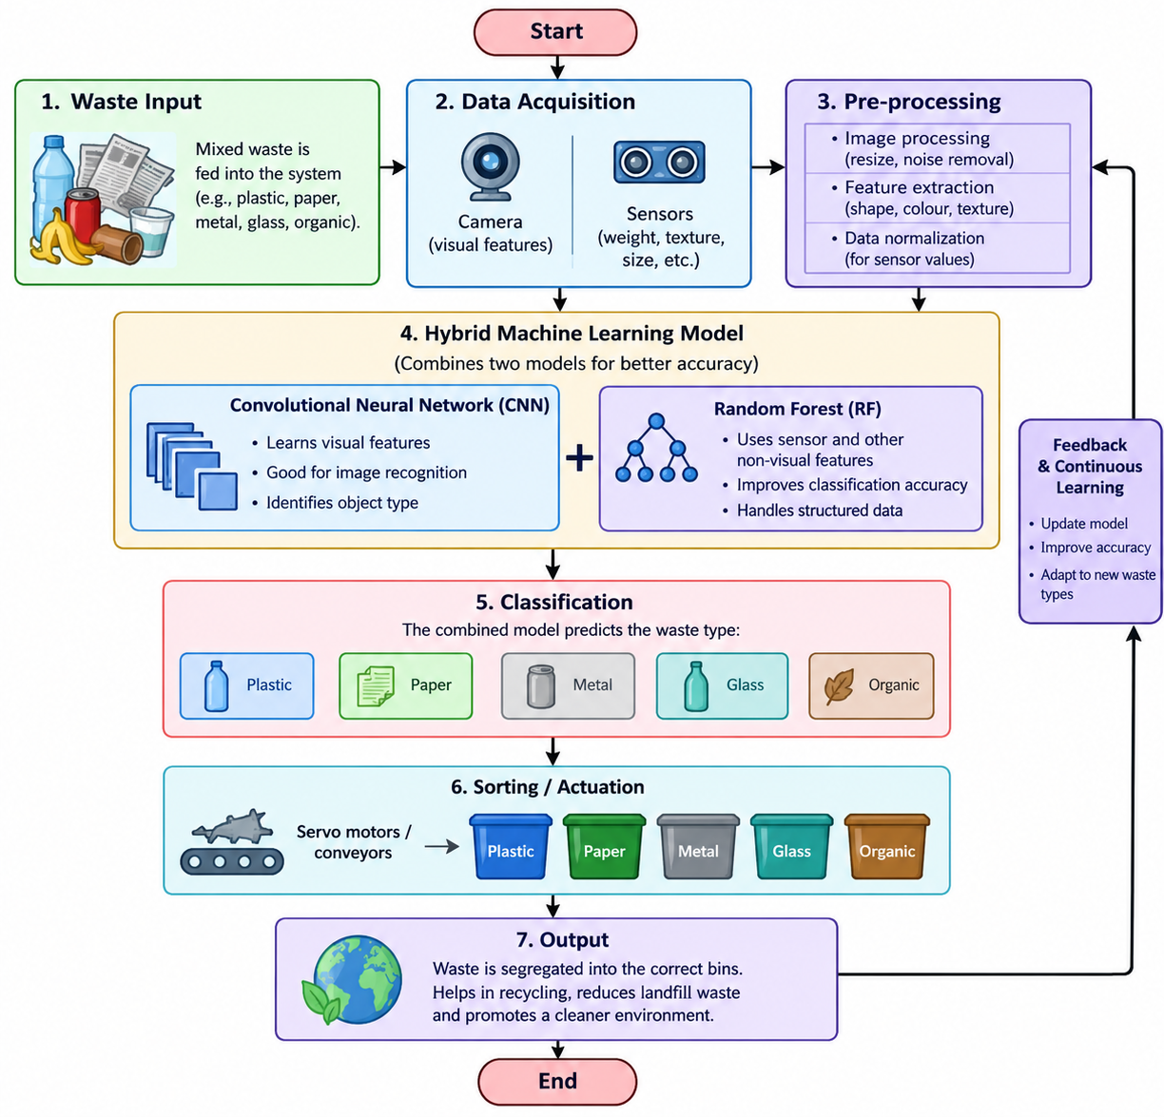
FLOW DIAGRAM
6

Slide 7
LITERATURE SURVEY (1/3)
# | Author / Venue (Year) | Method | Key Finding
1 | Zhang et al., Urban Climate (2023) | Hybrid deep model for solid waste | Hybrid design for solid-waste classification
2 | Lilhore et al., Multimedia Tools Appl. (2024) | CNN-LSTM + transfer learning | 95.45% precision; beat VGG-16, ResNet-34/50, AlexNet
3 | Kabilan et al., ICICNIS (2024) | Enhanced CNN architecture | Accurate waste classification for smart cities
4 | Gomathi & Narayanan, IEEE CICN (2024) | DL-aided classification system | Smart-city waste classification pipeline
5 | Murugan et al., ICC-ROBINS (2024) | DL-based hybrid image classifier | Hybrid model for solid-waste management
7

Slide 8
LITERATURE SURVEY (2/3)
# | Author / Venue (Year) | Method | Key Finding
6 | Multi-class CNN, Appl. Environ. Res. (2024) | MobileNetV2 / DenseNet121 transfer vs scratch | MobileNetV2 ~92% acc.; scratch model 65%
7 | Dry waste hybrid, JOIV (2024) | EfficientNet TL + PCA + CNN | Dimensionality reduction + CNN for dry waste
8 | SMARTSORT, E3S Web Conf. (2024) | YOLOv4 + Arduino Mega | Hands-free sorting of paper, plastic, metal
9 | Smart trash bank, IEEE CENIM (2024) | YOLOv8 + CNN + Firebase | Organic/inorganic sorting with app monitoring
10 | Tej et al., J. Mach. Comput. (2025) | Autoencoder + Vision Transformer | 96.72% precision; 96.46% F1
8

Slide 9
LITERATURE SURVEY (3/3)
# | Author / Venue (Year) | Method | Key Finding
11 | Husein et al., JIKI (2025) | HR-ViT: ResNet50 + ViT | Local + global features; 6 classes incl. batteries
12 | Rodrigues & Padmanabha, Sustainability (2025) | 11 pretrained CNNs + stacking ensemble | 98.29% test accuracy
13 | Deep ensemble, Sustainability 18(1) (2025) | Pretrained models + weighted averaging | Ensembling improves accuracy and stability
14 | Tanwer et al., Front. AI (2025) | ViT, Swin, PVT for bin fullness | ViT gave best accuracy on CDCM dataset
15 | Hybrid CNN-DenseNet121, EPJ Web Conf. 369 (2026) | 4-layer CNN + DenseNet121 | Beat single-model baselines on TrashNet
9

Slide 10
RESEARCH METHODOLOGY: HYBRID ALGORITHM
Stage 1 – Detection: YOLOv8-nano localises the item and crops the region of interest.
Stage 2 – Feature learning: EfficientNet-B0 / MobileNetV2 (transfer learning) extracts local texture and shape features.
Stage 3 – Global context: a lightweight Transformer (self-attention) encoder refines features; softmax gives class probabilities.
Stage 4 – Sensor fusion: Random Forest combines CNN-Transformer probabilities with moisture, inductive and capacitive readings.
Stage 5 – Decision: class with highest fused confidence drives the servo; low confidence goes to a "manual / unknown" bin.
10

Slide 11
ALGORITHM STEPS
1. Capture image; resize to 224×224, normalise, augment (flip, rotate, brightness).
2. Detect object with YOLOv8n; crop region.
3. F = EfficientNet(crop); Z = TransformerEncoder(F).
4. P_vision = Softmax(W·Z).
5. S = [moisture, inductive, capacitive]; P_final = RandomForest([P_vision, S]).
6. If max(P_final) ≥ 0.80 → open bin of that class; else → unknown bin.
Training: Adam, cross-entropy, early stopping. Metrics: accuracy, precision, recall, F1, latency (ms/frame).
11

Slide 12
COMPARE ALGORITHMS
Algorithm | Strength | Limitation | Edge suitability
CNN (VGG/ResNet) | Strong local features | Heavy; weak global context | Medium
MobileNetV2 / EfficientNet-B0 | Light, good with transfer learning | Limited on cluttered scenes | High
YOLOv8n | Real-time detection | Lower fine-grained accuracy | High
Vision Transformer | Global attention; high accuracy | Data- and compute-hungry | Low–Medium
CNN-LSTM hybrid | Good on organic vs recyclable | Sequential overhead for images | Medium
Proposed: YOLO + CNN-Transformer + sensors | Accuracy + speed + material cues | More components to integrate | High
Literature-reported results (different datasets, not directly comparable): CNN-LSTM 95.45% precision; AE+ViT 96.72%; stacking ensemble 98.29%; MobileNetV2 ~92%.
12

Slide 13
IMPLEMENTATION IDEA
Data: TrashNet + TACO / Kaggle waste datasets plus self-collected images; 80/10/10 split.
Training: Python, PyTorch, Google Colab GPU; export to ONNX / TFLite for the edge.
Hardware: Raspberry Pi 4 (or Jetson Nano), Pi camera, servo motors, ultrasonic, moisture, inductive and capacitive sensors.
Software: OpenCV pipeline, Flask/MQTT API, Firebase or ThingSpeak dashboard.
Evaluation: confusion matrix, F1, FPS and sorting accuracy on live trials vs. single-CNN baseline.
13

Slide 14
MODULES
1
2
3
4
5
Data Acquisition & Pre-processing
Hybrid ML Classification
Sensor Fusion
Segregation Actuation
IoT Monitoring Dashboard
Camera, dataset, augmentation
YOLOv8n + CNN-Transformer
Moisture / metal / capacitive + RF
Servo / conveyor bin control
Fill level, stats, alerts
14

Slide 15
MODULE 1: DATA ACQUISITION & PRE-PROCESSING
Collects and prepares clean, labelled images for the model.
Input
Process
Output
Waste image from Pi camera
TrashNet, TACO, Kaggle sets + self-collected images
Resize to 224×224, normalise, denoise
Augment: flip, rotate, brightness
Label classes; 80/10/10 split
Clean labelled frames / tensors
Tools: OpenCV, NumPy, Roboflow
15

Slide 16
MODULE 2: HYBRID ML CLASSIFICATION
Core intelligence: detects the item and classifies it.
Input
Process
Output
Pre-processed frame
YOLOv8n detects and crops the item
EfficientNet-B0 extracts local features
Transformer encoder adds global context
Softmax gives class probabilities
Bounding box + class probabilities (P_vision)
Tools: PyTorch, ONNX / TFLite; metrics: accuracy, F1, latency
16

Slide 17
MODULE 3: SENSOR FUSION
Uses material cues to fix visually confusing items.
Input
Process
Output
P_vision from Module 2
Moisture, inductive (metal), capacitive readings
Normalise sensor values
Random Forest on [P_vision, sensors]
Confidence threshold of 0.80
Final class + confidence score
Tools: scikit-learn, Arduino / Pi GPIO sensors
17

Slide 18
MODULE 4: SEGREGATION ACTUATION
Physically drops the item into the right bin.
Input
Process
Output
Final class from Module 3
Pi sends signal to servo driver
Diverter / lid rotates to the matching bin
Low confidence goes to the "unknown" bin
Reset after a timeout
Item sorted into Wet / Dry / Recyclable / Hazardous bin
Tools: Servo motors, motor driver, optional conveyor
18

Slide 19
MODULE 5: IOT MONITORING DASHBOARD
Gives live visibility of bins and system performance.
Input
Process
Output
Ultrasonic fill level
Class counts and confidence logs
Send data via MQTT / HTTP to the cloud
Alert when a bin is 80% full
Save low-confidence images for retraining
Live dashboard, alerts and reports
Tools: Firebase / ThingSpeak, Flask, MQTT
19

Slide 20
CONCLUSION
A hybrid ML pipeline (YOLO + CNN-Transformer + sensor fusion) addresses the accuracy and edge-deployment gaps seen in single-model waste classifiers.
Literature from 2023–2026 shows hybrid and ensemble models consistently outperform single CNNs.
The 5-module design gives an end-to-end, low-cost smart bin with IoT monitoring.
Future work: multi-object scenes, domain adaptation, robotic-arm sorting and larger real-world datasets.
20

